Slide 1


Saudi Arabia Stock Market and Oil Market Analysis
Creig Luke 232626036
Harishankar Arun 232626033

Slide 2
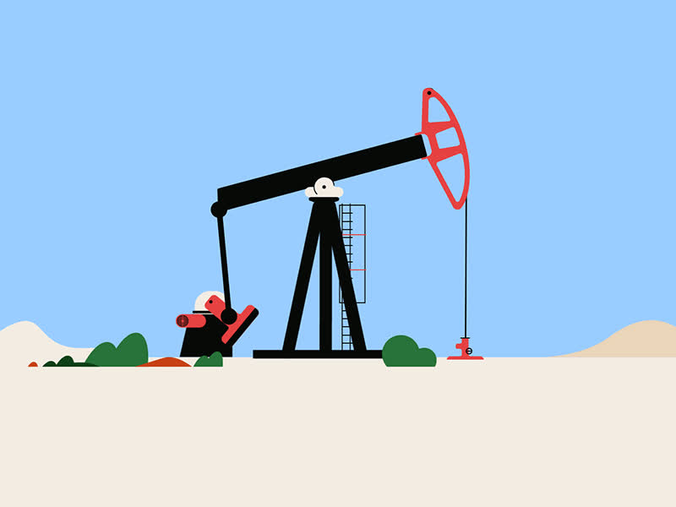
HISTORY OF THE SAUDI ARABIAN ECONOMY
Pre-Oil Era (Before 1938)
Economy based on agriculture, trade, and religious tourism (Mecca & Medina).
Limited industrial development, focused on subsistence farming and regional trade.
Oil Discovery and Boom (1938-1980s)
1938: Oil discovered in Eastern Province, transforming the economy.
1973: OPEC oil embargo increased prices; Saudi Arabia became a major oil producer.
Oil revenues funded infrastructure & education, increased dependency on oil.
Diversification Efforts (1990s-2010s)
Declining oil prices in the 1980s/90s highlighted economic vulnerability.
Efforts to diversify into petrochemicals, telecom, and tourism.
Joined WTO in 2005, aim for global economic integration.
Vision 2030 (2016-Present)
Ambitious reform plan by Crown Prince to reduce oil dependency.
Focus on developing tourism, tech, and renewable energy (e.g., NEOM city).
COVID-19 accelerated digital transformation and reforms.

Slide 3

HISTORY OF THE SAUDI STOCK MARKET (TADAWUL)
Formation & Early Development (1980s-2000s)
1980s: Informal market, later formalized as Tadawul.
2003: Capital Market Authority (CMA) established to regulate the market.
Growth driven by increased oil revenues and domestic investments.
Market Reforms & Aramco IPO (2010s-Present)
2015: Market opened to foreign institutional investors.
2019: Saudi Aramco IPO raised $25.6 billion, the world’s largest IPO.
Tadawul is now the largest stock market in the Middle East, supporting Vision 2030 goals.

Slide 4

HISTORY OF THE SAUDI OIL MARKET
Rise as an Oil Power
Early Days(1940s-1970s)
1950s-60s: Rapid expansion of oil production; Saudi Aramco becomes a key global player.
1973: Oil crisis solidifies Saudi Arabia’s influence in OPEC and global energy markets.
Nationalization of Aramco in the 1970s gives full control to the Saudi government.
Market Challenges & OPEC+ (1980s-2020s)
1980s-90s: Price fluctuations lead to budget challenges and highlight need for diversification.
2010s: U.S. shale boom introduces competition; Saudi Arabia leads OPEC+ alliance with Russia to stabilize prices
2020: COVID-19 pandemic leads to historic demand drop and production cuts.
Focus on balancing oil production while investing in renewable energy as part of Vision 2030.

Slide 5
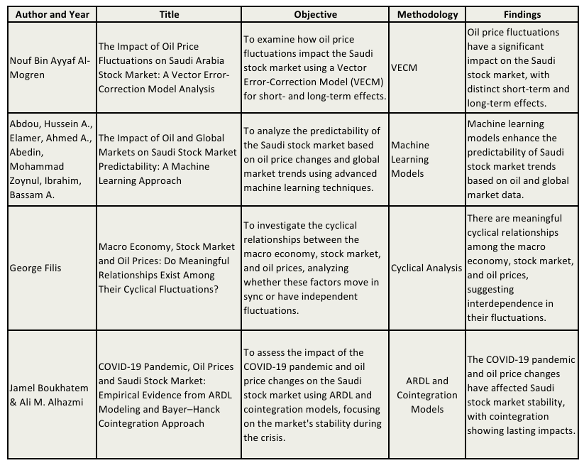
LITERATURE REVIEWS

Slide 6

OBJECTIVE OF THE STUDY
This study explores the transformation of Saudi Arabia’s economy, stock market, and oil industry, providing insights into key aspects like:
Impact of Oil Dependency: Evaluates the risks of oil reliance and highlights the need for diversification through initiatives like Vision 2030.
Diversification Efforts: Assesses the effectiveness of reforms in reducing oil dependency and fostering growth in non-oil sectors.
Reducing dependency on Oil: Checking the extent of reduction of oil dependency.

Slide 7
Data Description
Saudi Stock Market:
Data range: Jan 2010 to Sep 2024
Frequency: Daily
Source: trandingeconomics.com
OPEC Basket:
Data range: Jan 2003 to Sep 2024
Frequency: Daily
Source: opec.org

Slide 8
Summary Statistics
Price:
Min. : 5323 (2nd March 2011)
Max. :13820 (8th May 2022)
Median : 7915
Mean : 8489
High:
Min. : 5472 (3rd October 2016) Max. :13949 (9th May 2022)
Median : 7966
Mean : 8532
Value:
Min. : 12.22 (22nd April 2020)
Max. :140.73 (3rd July 2008)
Median : 67.92
Mean : 70.30
Change (%):
Min. : -0.0832000 (8th March 2020)
Max. :0.0892000 (18th December 2014)

Slide 9
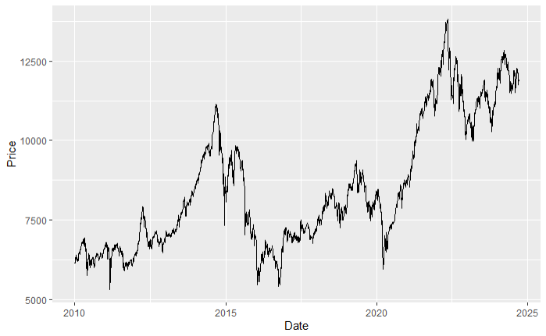
Plot: Closing Price w.r.t date
Notes:
Key Peaks: Around 2015 and 2021, indicating high price levels.Notable Dips: Sharp declines in 2016 and 2020, likely due to economic downturns.Recovery: Strong rebound post-2020 dip, reaching a peak in 2022, followed by stabilization at lower levels.

Slide 10
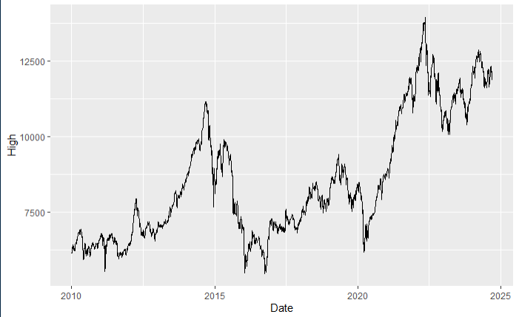
Plot: High w.r.t date
Notes:
Volatile Market: The Tadawul index shows significant swings, including sharp declines and subsequent recoveries, typical of market responses to global and local economic conditions.Recent Performance (2024): The most recent data indicates that the index hovers around 11,800 points, showing short-term fluctuations but no major crash.Recovery and Growth: Since the dip around 2020, there has been a steady increase, peaking in 2022, followed by corrections but maintaining higher levels than the early 2010s.

Slide 11
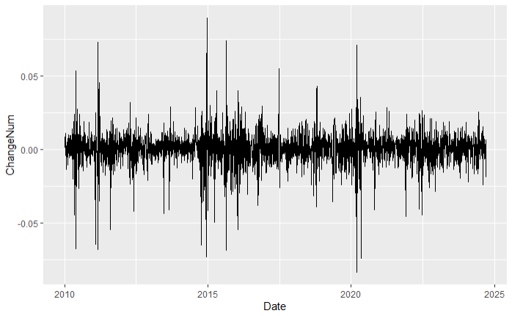
Plot: Change w.r.t date
Notes:
The plot shows that there are periods of large volatility in the stock price, as evidenced by the large spikes. The plot also shows that there are periods of relative stability, as evidenced by the long periods of time where the change in stock price is relatively small

Slide 12
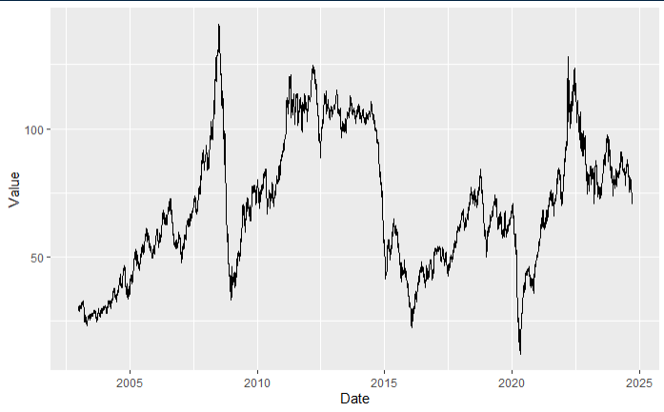
OPEC Basket Value over time
Notes:
2003-2008: The value steadily increases, peaking before the 2008 financial crisis, reflecting the global demand for oil.2008-2009: A sharp decline is visible, coinciding with the global recession, reducing oil demand.2010-2014: Recovery and stabilization occur, with prices remaining relatively high due to economic growth.2014-2016: A significant drop reflects a global supply glut and reduced demand, leading to a downturn in prices.2017-2019: Prices stabilize with moderate fluctuations, reflecting OPEC's efforts to manage supply.2020: A sharp dip corresponds to the COVID-19 pandemic, which drastically reduced global oil demand.2021-2022: A recovery follows as global economies reopen, boosting demand.2023-2025: Prices show volatility, influenced by market uncertainties and OPEC production decisions.

Slide 13
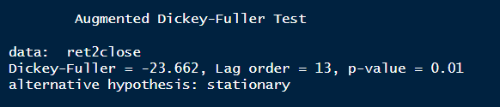
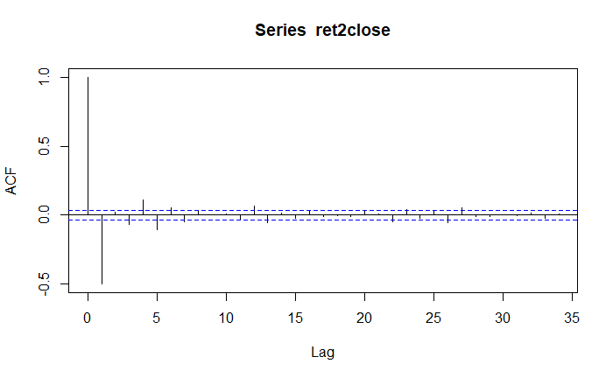
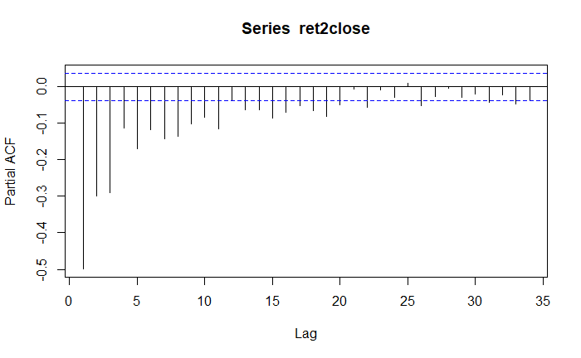
Preliminary Tests: Saudi Stock Closing Price
ADF Test:
ACF
PACF
Notes:
Stationarity Check: The ADF Test shows a Dickey-Fuller statistic of -23.662 with a p-value of 0.01, confirming that the Saudi stock closing price series is stationary.
ACF (Autocorrelation Function): Significant autocorrelation at the initial lags, which fades over time, suggesting some dependence structure in the series.
PACF (Partial Autocorrelation Function): A sharp drop after the first lag indicates that an AR(1) model might be suitable for modelin

Slide 14
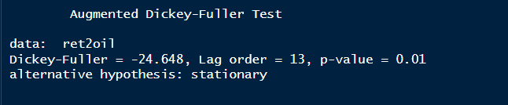
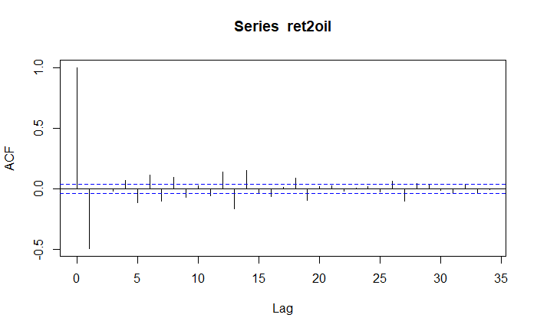
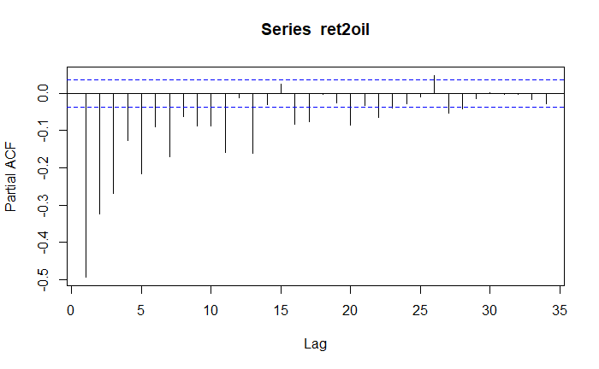
Preliminary Tests: OPEC Basket
ADF Test:
ACF
PACF
Notes:
Stationarity Check: The ADF Test reports a Dickey-Fuller statistic of -24.648 with a p-value of 0.01, confirming that the OPEC Basket price series is stationary.
ACF (Autocorrelation Function): Shows initial positive autocorrelation that quickly dissipates, indicating limited short-term memory in the series.
PACF (Partial Autocorrelation Function): A rapid decline after the first lag, again suggesting a potential AR(1) model for the data.

Slide 15
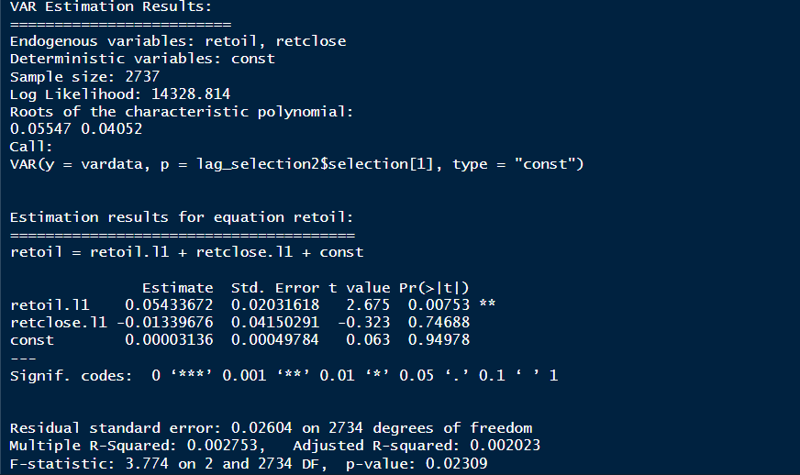

Slide 16
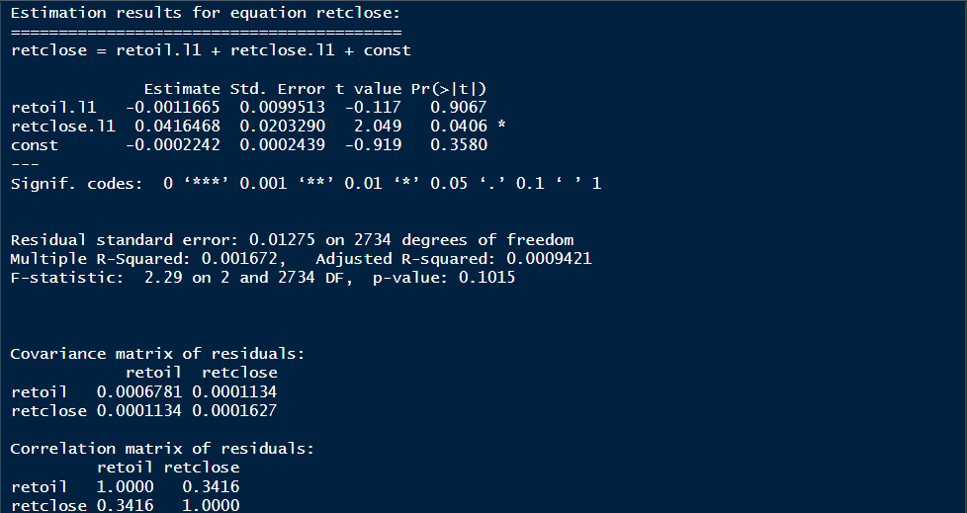

Slide 17
Equation 1: retoil
Dependent Variable: retoil
Independent Variables: retoil.l1 (lagged value of retoil), retclose.l1 (lagged value of retclose), and a constant term.
The coefficient of retoil.l1 is significant (p-value = 0.00753), suggesting that past values of retoil have a statistically significant effect on the current value of retoil.
The coefficient for retclose.l1 is not significant (p-value = 0.74688), indicating that the lagged return of closing prices does not have a statistically significant impact on the return of oil prices.
The constant term is not statistically significant, implying that there is no substantial baseline effect.
Equation 2: retclose
Dependent Variable: retclose
Independent Variables: retoil.l1, retclose.l1, and a constant term.
The coefficient of retclose.l1 is significant (p-value = 0.0406), indicating that past values of retclose have a statistically significant impact on the current value of retclose.
The coefficient of retoil.l1 is not significant (p-value = 0.9067), meaning that past values of retoil do not have a significant effect on retclose.
The constant term is again not significant.
The correlation between retoil and retclose residuals is 0.3416, which indicates a moderate positive relationship.

Slide 18
Impulse response Function results
Impulse response coefficients
$retoil
retclose
[1,] 0.0043566038805094549693
[2,] 0.0001510629050791071314
[3,] 0.0000047088532576619419
[4,] 0.0000001124851700690604
[5,] 0.0000000002144083910613
[6,] -0.0000000002322108336009
[7,] -0.0000000000227702578117
[8,] -0.0000000000016637167306
[9,] -0.0000000000001085172629
[10,] -0.0000000000000066769599
[11,] -0.0000000000000003970048
Lower Band, CI= 0.95
$retoil
retclose
[1,] 0.0031204832757174544
[2,] -0.0003067878116480503
[3,] -0.0000384753681899556
[4,] -0.0000041824793554175
[5,] -0.0000003644127733719
[6,] -0.0000000321584895714
[7,] -0.0000000027753238979
[8,] -0.0000000002369838809
[9,] -0.0000000000201608200
[10,] -0.0000000000017158324
[11,] -0.0000000000001464539
Upper Band, CI= 0.95
$retoil
retclose
[1,] 0.0058375885153389411
[2,] 0.0006626192369359810
[3,] 0.0000667749345053867
[4,] 0.0000051637484409060
[5,] 0.0000004922613301596
[6,] 0.0000000458643853453
[7,] 0.0000000041905806870
[8,] 0.0000000003684201186
[9,] 0.0000000000340808521
[10,] 0.0000000000032142857
[11,] 0.0000000000002916643

Slide 19
The results represent the impulse response function (IRF) for the impact of a shock in the variable "retoil" on "retclose" over 11 time periods.
The impulse response function provides a main coefficient per time period, along with a 95% confidence interval given by the lower and upper bounds.
Each coefficient under "retclose" in the Impulse Response Coefficients section represents the expected response of "retclose" to a one-unit shock in "retoil" at each time period.
The effects diminish significantly as the lags increase.
The first period shows a statistically significant positive impact on "retclose" from a shock to "retoil", indicating that initially, an increase in "retoil" positively affects "retclose".

Slide 20
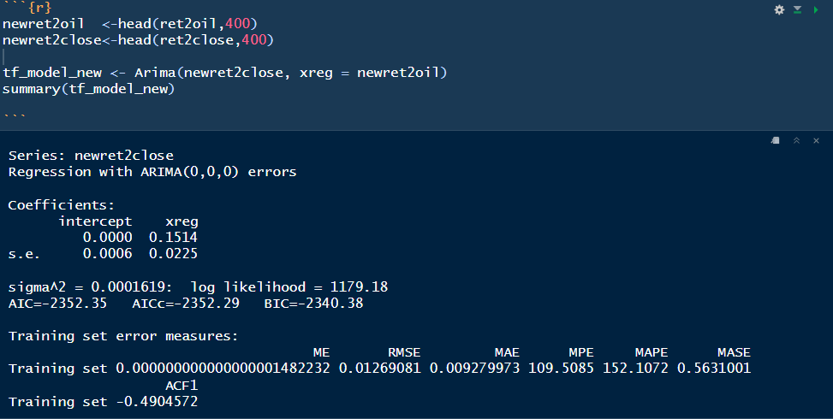

Slide 21
Intercept: The intercept is 0.0000 with a standard error of 0.0006, suggesting it is not statistically different from zero. This means that in the absence of a change in roil value, the baseline effect on close price is essentially zero.
xreg (ret2oil): The coefficient for ret2oil is 0.1514, with a standard error of 0.0225. This coefficient represents the direct effect of oil on price close. A one-unit change in ret2oil is associated with a 0.1514 unit change in newret2close.
The low standard error relative to the coefficient suggests this is a statistically significant relationship.
Since the coefficient is positive, this means an increase in ret2oil generally results in an increase in newret2close.

Slide 22
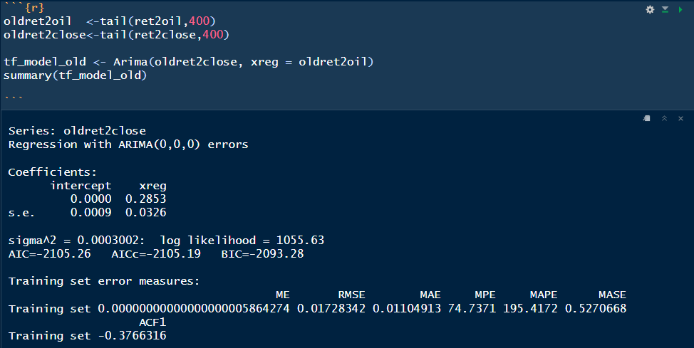

Slide 23
Coefficients and Their Interpretation
Intercept: The intercept value is 0.0000 with a standard error of 0.0009. This essentially means that in the absence of any change in oldret2oil, there is no baseline change in oldret2close. Given the standard error, this intercept is not statistically different from zero.
xreg (oldret2oil): The coefficient for oldret2oil is 0.2853 with a standard error of 0.0326. This positive coefficient suggests that a one-unit increase in oldret2oil is associated with a 0.2853 unit increase in oldret2close.
The standard error is relatively small, which makes this estimate statistically significant, indicating that oldret2oil has a meaningful and direct effect on oldret2close.

Slide 24
Overall:
The coefficient of the ‘reg’ for the transfer function of newer data points (newret2oil) is 0.1514 which is lesser than that of the older data points(oldret2oil).
The lowering of coefficient shows that Saudi Arabia’s reliance on oil has reduced over the years.
With plans such as Vision 2030 and bid to host FIFA world cup in future, Saudi Arabia plans to diversify to other industries such as communication, sports and tourism.

Slide 25
CONCLUSION
Stock-Oil Relationship: The analysis indicates a strong correlation between Saudi Arabia’s stock market performance and fluctuations in global oil prices, highlighting the country's economic dependence on the oil sector.
Trend Analysis: Visualizations show that significant drops in oil prices often correspond with downward movements in stock prices.
Implications for Investors: Understanding this relationship can guide investment decisions in the Saudi stock market, emphasizing the need to monitor global oil market trends for potential stock market shifts.
Plans to diversify Saudi market to sectors other than oil, as a part of Vision 2030 by Crown prince M.B. Salman

Slide 26
THANK YOU!

